Slide 1
HW2
Xinyi Xu
Ziyue Qin

Slide 2
Motivation
1.Code the pdf plot from Slide20,DEDA, Unit5
import numpy as np
import matplotlib.pyplot as plt
from matplotlib.backends.backend_tkagg import FigureCanvasTkAgg, NavigationToolbar2Tk
import scipy.stats as stats
import tkinter as tk
from ipywidgets import widgets
from IPython.display import display
import matplotlib
# 设置使用TkAgg后端
matplotlib.use('TkAgg')
class InteractiveDistribution:
def __init__(self, root):
self.root = root
self.root.title("正态分布可视化")
self.root.geometry("900x700")
# 创建控制面板
control_frame = tk.Frame(root, padx=10, pady=10)
control_frame.pack(side=tk.TOP, fill=tk.X)
# 创建图形框架
fig_frame = tk.Frame(root)
fig_frame.pack(side=tk.TOP, fill=tk.BOTH, expand=True)
# 初始化参数
self.mu = 0
self.sigma = 1.0
self.colour = 'blue'
# 创建滑块和选择器
self.create_controls(control_frame)
# 创建图形
self.fig, (self.ax1, self.ax2) = plt.subplots(2, 1, figsize=(8, 8))
self.fig.patch.set_facecolor('#eeefef')
# 将图形嵌入到Tkinter窗口
self.canvas = FigureCanvasTkAgg(self.fig, master=fig_frame)
self.canvas.get_tk_widget().pack(side=tk.TOP, fill=tk.BOTH, expand=1)
# 添加工具栏
toolbar = NavigationToolbar2Tk(self.canvas, fig_frame)
toolbar.update()
# 初始绘图
self.update_plot()
def create_controls(self, frame):
"""创建交互控件"""
# μ 滑块
mu_label = tk.Label(frame, text="均值 (μ):")
mu_label.grid(row=0, column=0, sticky=tk.W)
self.mu_slider = tk.Scale(frame, from_=-10, to=10, orient=tk.HORIZONTAL,
command=self.on_mu_change, length=300)
self.mu_slider.set(self.mu)
self.mu_slider.grid(row=0, column=1, sticky=tk.W)
# σ 滑块
sigma_label = tk.Label(frame, text="标准差 (σ):")
sigma_label.grid(row=1, column=0, sticky=tk.W)
self.sigma_slider = tk.Scale(frame, from_=0.5, to=5, resolution=0.1,
orient=tk.HORIZONTAL, command=self.on_sigma_change,
length=300)
self.sigma_slider.set(self.sigma)
self.sigma_slider.grid(row=1, column=1, sticky=tk.W)

Slide 3
# 颜色选择
color_label = tk.Label(frame, text="颜色:")
color_label.grid(row=2, column=0, sticky=tk.W)
self.color_var = tk.StringVar(value=self.colour)
colors = ['red', 'green', 'blue', 'purple', 'orange’]
color_frame = tk.Frame(frame)
color_frame.grid(row=2, column=1, sticky=tk.W)
for color in colors:
rb = tk.Radiobutton(color_frame, text=color, variable=self.color_var,
value=color, command=self.on_color_change)
rb.pack(side=tk.LEFT, padx=5)
def on_mu_change(self, value):
"""处理μ值变化"""
self.mu = float(value)
self.update_plot()
def on_sigma_change(self, value):
"""处理σ值变化"""
self.sigma = float(value)
self.update_plot()
def on_color_change(self):
"""处理颜色变化"""
self.colour = self.color_var.get()
self.update_plot()
def update_plot(self):
"""更新图形"""
# 清除之前的图形
self.ax1.clear()
self.ax2.clear()
# 设置x轴范围
x_axis = np.linspace(-10, 10, 1000)
# 上部分：PDF
self.ax1.plot(x_axis, stats.norm.pdf(x_axis, self.mu, self.sigma),
c=self.colour, linewidth=2)
self.ax1.set_xlabel('X')
self.ax1.set_ylabel('pdf')
self.ax1.set_ylim(0, 1)
self.ax1.set_xlim(-10, 10)
self.ax1.set_title(f'概率密度函数 (μ={self.mu}, σ={self.sigma:.2f})’,
fontweight="bold")
self.ax1.grid(True, alpha=0.3)
# 下部分：CDF
self.ax2.plot(x_axis, stats.norm.cdf(x_axis, self.mu, self.sigma),
c=self.colour, linewidth=2)
self.ax2.set_xlabel('X')
self.ax2.set_ylabel('cdf')
self.ax2.set_ylim(0, 1)
self.ax2.set_xlim(-10, 10)
self.ax2.set_title(f'累积分布函数 (μ={self.mu}, σ={self.sigma:.2f})’,
fontweight="bold")
self.ax2.grid(True, alpha=0.3)
# 调整布局
self.fig.tight_layout(pad=3.0)
# 重绘图形
self.canvas.draw()
# 创建主窗口
root = tk.Tk()
app = InteractiveDistribution(root)
root.mainloop()

Slide 4
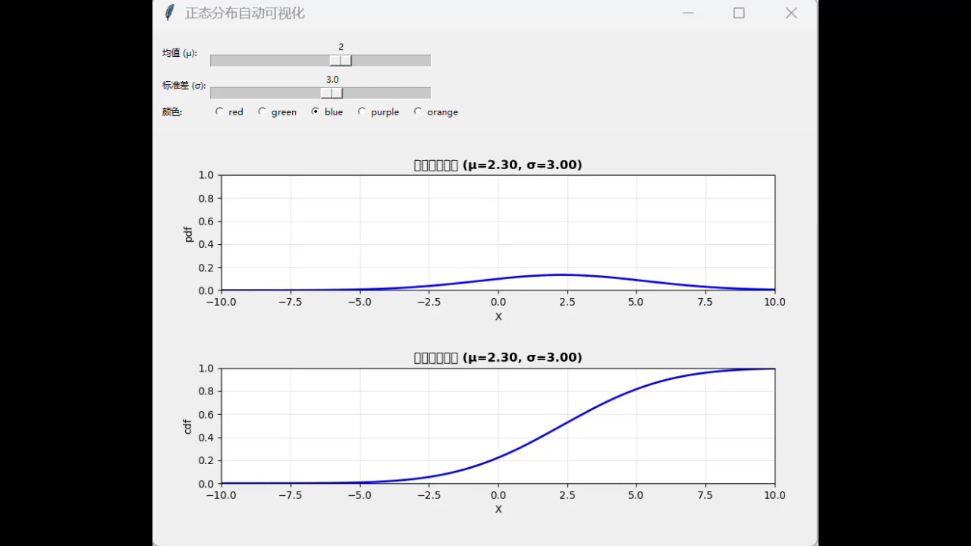
Clustering
Automatic visualization of normal distributions
Notes:
20161215 Shanghai C YH Chen, W K Härdle
45 min a crash course in R from BCS slides, see LvB Metis (CC)
30 min Quantlet introduction
45 min CRIX (WKH)
45 min Econometrics of CRIX (CC)
60 min SDA Text Scraping + Classification (CC)
45 min SDA SVM (WKH)
60 min Distillation of news flows + sector specific sentiments (CC)
45 min SDA Dynamic Topic Modelling (WKH)
45 min SDA applications (WKH+CC)
45 min TEDAS TED Asset Allocation (WKH)
45 min Tail Event driven Network AR

Slide 5

Clustering
2.A N( mu, SIGMA) in a rotating plot
import numpy as np
import plotly.graph_objects as go
# 定义参数
mu = 0
sigma = 1
x = np.linspace(mu - 3*sigma, mu + 3*sigma, 50)
y = np.linspace(mu - 3*sigma, mu + 3*sigma, 50)
X, Y = np.meshgrid(x, y)
Z = np.exp(-( (X-mu)**2 + (Y-mu)**2 )/(2*sigma**2)) / (2*np.pi*sigma**2)
# 创建3D曲面图
fig = go.Figure(data=[go.Surface(x=X, y=Y, z=Z, colorscale='Viridis')])
fig.update_layout(
title='3D Rotatable Normal Distribution',
scene=dict(
xaxis_title='X',
yaxis_title='Y',
zaxis_title='Z'
),
width=800,
height=600
)
fig.show() # 可自由旋转查看
Notes:
20161215 Shanghai C YH Chen, W K Härdle
45 min a crash course in R from BCS slides, see LvB Metis (CC)
30 min Quantlet introduction
45 min CRIX (WKH)
45 min Econometrics of CRIX (CC)
60 min SDA Text Scraping + Classification (CC)
45 min SDA SVM (WKH)
60 min Distillation of news flows + sector specific sentiments (CC)
45 min SDA Dynamic Topic Modelling (WKH)
45 min SDA applications (WKH+CC)
45 min TEDAS TED Asset Allocation (WKH)
45 min Tail Event driven Network AR

Slide 6
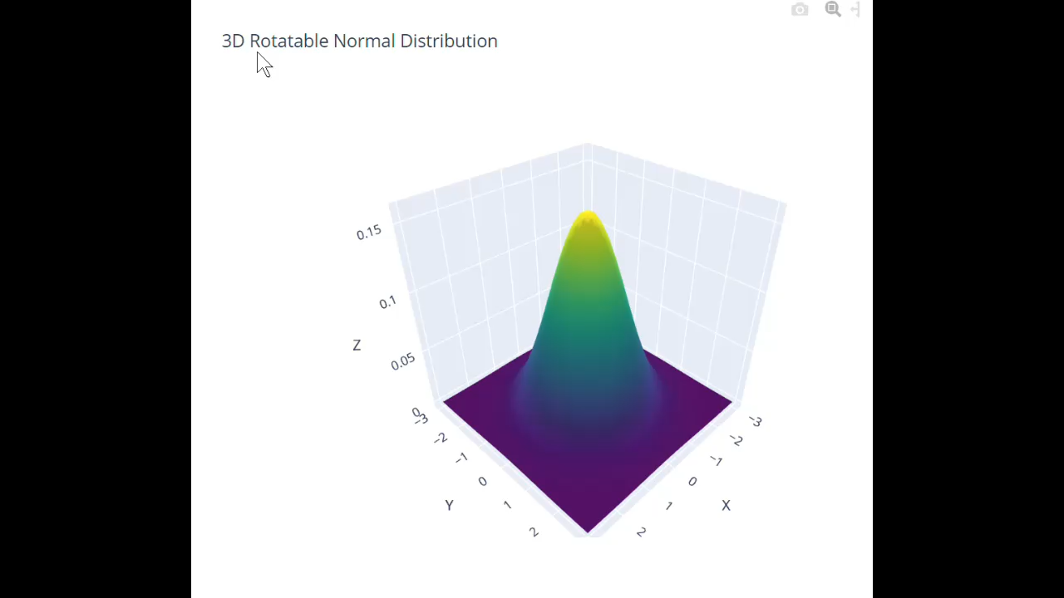
Clustering
3D Rotatable Normal Distribution
Notes:
20161215 Shanghai C YH Chen, W K Härdle
45 min a crash course in R from BCS slides, see LvB Metis (CC)
30 min Quantlet introduction
45 min CRIX (WKH)
45 min Econometrics of CRIX (CC)
60 min SDA Text Scraping + Classification (CC)
45 min SDA SVM (WKH)
60 min Distillation of news flows + sector specific sentiments (CC)
45 min SDA Dynamic Topic Modelling (WKH)
45 min SDA applications (WKH+CC)
45 min TEDAS TED Asset Allocation (WKH)
45 min Tail Event driven Network AR

Slide 7
Clustering
3.Repair of the slider plot for BTC
import pandas as pd
import requests
import plotly.express as px
from dash import Dash, dcc, html
from dash.dependencies import Input, Output
# =========== 获取BTC历史价格数据 =============
def get_btc_data(days=365):
url = "https://api.coingecko.com/api/v3/coins/bitcoin/market_chart"
params = {
"vs_currency": "usd",
"days": days,
"interval": "daily"
}
resp = requests.get(url, params=params)
data = resp.json()
prices = data['prices']
df = pd.DataFrame(prices, columns=['Timestamp', 'Price'])
df['Date'] = pd.to_datetime(df['Timestamp'], unit='ms')
return df[['Date', 'Price']]
df = get_btc_data(365)
# =========== Dash 应用 =============
app = Dash(__name__)
app.layout = html.Div([
html.H1("比特币 (BTC) 最近一年历史价格滑动图",
style={"textAlign": "center"}),
dcc.Slider(
id='price-slider',
min=0,
max=len(df)-1,
step=1,
value=len(df)-1,
marks={i: df.iloc[i]["Date"].strftime("%m-%d") for i in
range(0, len(df), 30)},
tooltip={"placement": "bottom", "always_visible": False}
),
dcc.Graph(id='btc-price-graph')
])
@app.callback(
Output('btc-price-graph', 'figure'),
Input('price-slider', 'value')
)
def update_graph(selected_index):
filtered_df = df.iloc[:selected_index+1]
fig = px.line(filtered_df, x='Date', y='Price', title='BTC 最近一年价格走势')
fig.update_traces(line_color='orange')
fig.update_layout(transition_duration=300)
return fig
if __name__ == '__main__':
app.run(debug=True)
Notes:
20161215 Shanghai C YH Chen, W K Härdle
45 min a crash course in R from BCS slides, see LvB Metis (CC)
30 min Quantlet introduction
45 min CRIX (WKH)
45 min Econometrics of CRIX (CC)
60 min SDA Text Scraping + Classification (CC)
45 min SDA SVM (WKH)
60 min Distillation of news flows + sector specific sentiments (CC)
45 min SDA Dynamic Topic Modelling (WKH)
45 min SDA applications (WKH+CC)
45 min TEDAS TED Asset Allocation (WKH)
45 min Tail Event driven Network AR

Slide 8
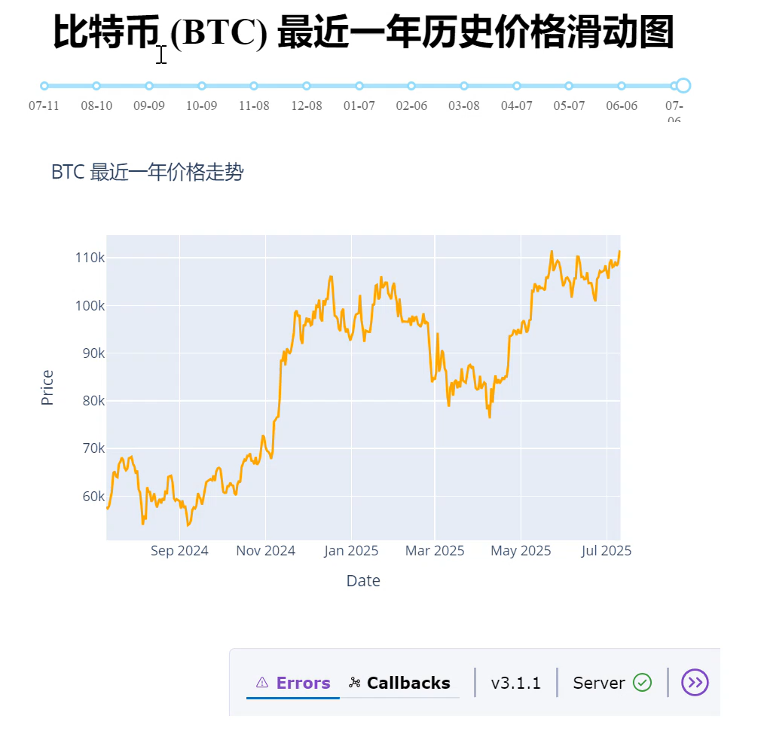
Clustering
BTC historical price sliding chart for the past year
Notes:
20161215 Shanghai C YH Chen, W K Härdle
45 min a crash course in R from BCS slides, see LvB Metis (CC)
30 min Quantlet introduction
45 min CRIX (WKH)
45 min Econometrics of CRIX (CC)
60 min SDA Text Scraping + Classification (CC)
45 min SDA SVM (WKH)
60 min Distillation of news flows + sector specific sentiments (CC)
45 min SDA Dynamic Topic Modelling (WKH)
45 min SDA applications (WKH+CC)
45 min TEDAS TED Asset Allocation (WKH)
45 min Tail Event driven Network AR

Slide 9
Clustering
A RF example
Below is a classic example of implementing random forest classification using Scikit-learn (Iris dataset):
import pandas as pd
import matplotlib.pyplot as plt
from sklearn.ensemble import RandomForestClassifier
from sklearn.datasets import load_iris
from sklearn.model_selection import train_test_split
from sklearn.metrics import accuracy_score, classification_report
# 加载数据
iris = load_iris()
X, y = iris.data, iris.target
# 划分数据
X_train, X_test, y_train, y_test = train_test_split(X, y, test_size=0.3, random_state=42)
# 训练模型
rf = RandomForestClassifier(n_estimators=100, random_state=42)
rf.fit(X_train, y_train)
# 预测 & 评估
y_pred = rf.predict(X_test)
print(f"Accuracy: {accuracy_score(y_test, y_pred):.2f}")
print("\nClassification Report:\n", classification_report(y_test, y_pred))
# 可视化特征重要性
feature_importance = pd.Series(rf.feature_importances_, index=iris.feature_names)
feature_importance.sort_values().plot(kind='barh', title='Feature Importance')
plt.xlabel("Feature Importance Score")
plt.tight_layout()
plt.show()
Notes:
20161215 Shanghai C YH Chen, W K Härdle
45 min a crash course in R from BCS slides, see LvB Metis (CC)
30 min Quantlet introduction
45 min CRIX (WKH)
45 min Econometrics of CRIX (CC)
60 min SDA Text Scraping + Classification (CC)
45 min SDA SVM (WKH)
60 min Distillation of news flows + sector specific sentiments (CC)
45 min SDA Dynamic Topic Modelling (WKH)
45 min SDA applications (WKH+CC)
45 min TEDAS TED Asset Allocation (WKH)
45 min Tail Event driven Network AR

Slide 10
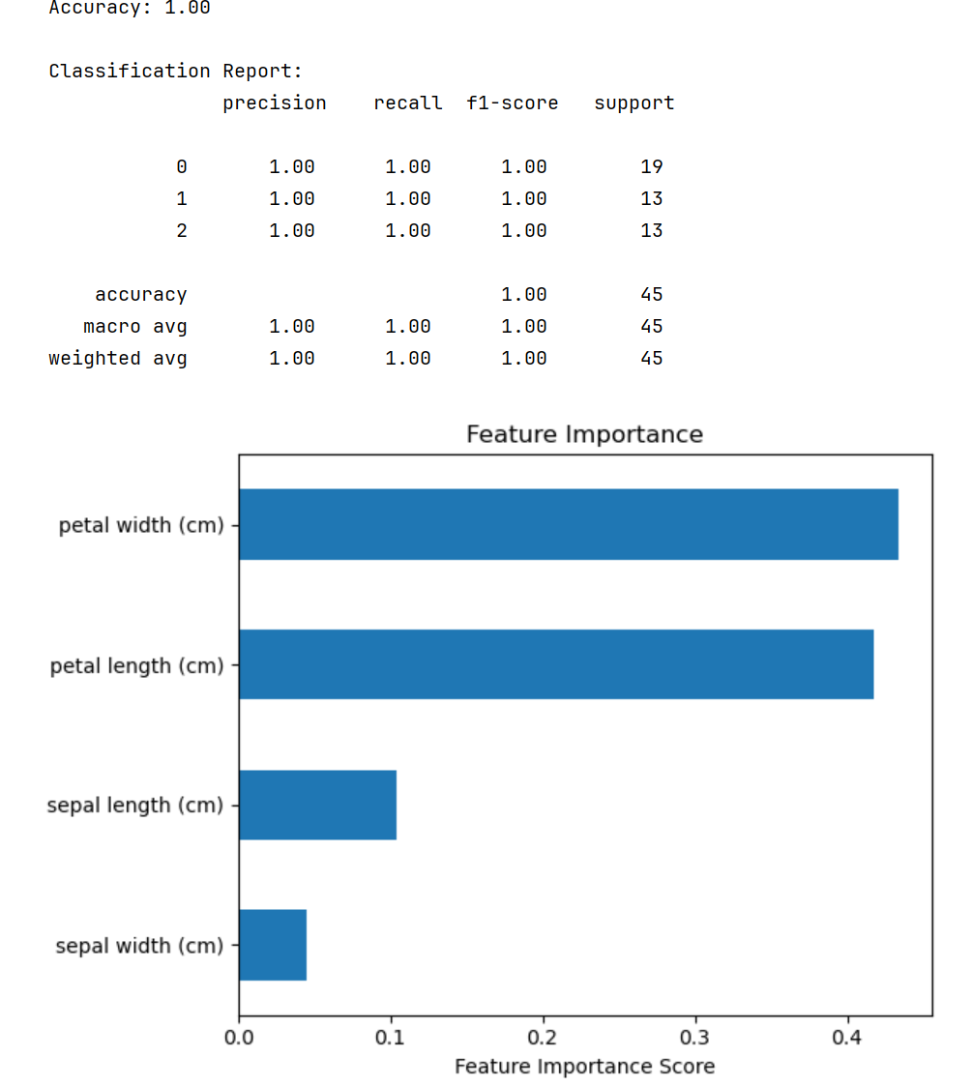
Clustering
Iris dataset
Notes:
20161215 Shanghai C YH Chen, W K Härdle
45 min a crash course in R from BCS slides, see LvB Metis (CC)
30 min Quantlet introduction
45 min CRIX (WKH)
45 min Econometrics of CRIX (CC)
60 min SDA Text Scraping + Classification (CC)
45 min SDA SVM (WKH)
60 min Distillation of news flows + sector specific sentiments (CC)
45 min SDA Dynamic Topic Modelling (WKH)
45 min SDA applications (WKH+CC)
45 min TEDAS TED Asset Allocation (WKH)
45 min Tail Event driven Network AR

